Slide 1

Learn Programming For Kids (Python)

Slide 2
Lesson 5
Python Datatypes Practical

Slide 3
Play with Python Integers

Slide 4
Example 1: How to take integer input in Python?
We will see how to take integer input in Python. As we know that Python’s built-in input() function always returns a str(string) class object. So for taking integer input we have to type cast those inputs into integers by using Python built-in int() function.

Slide 5
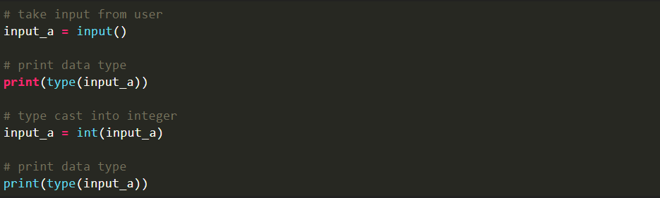
Code:

Slide 6
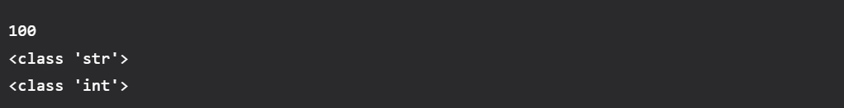
Output:

Slide 7
Play with Python Float

Slide 8
Example 1: How to take float input in Python?
Python float() function is used to return a floating-point number from a number or a string representation of a numeric value.

Slide 9

Code:

Slide 10

Output:

Slide 11
Play with Python Strings:

Slide 12
Example 1: Find out the length of a string in Python
Using the built-in function len(). The built-in function len returns the number of items in a container.

Slide 13
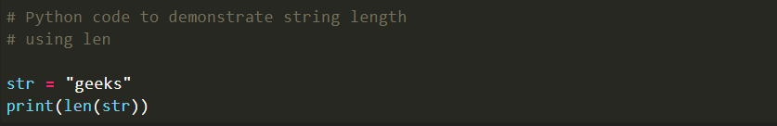
Code:

Slide 14

Output:

Slide 15
Example 2: How to join two strings in Python?
String concatenation is the process of joining two or more strings together and forming one single string. You can use the + operator, or use a built-in function like str.join() to concatenate two strings.

Slide 16
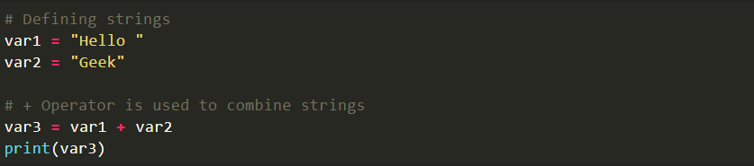
Code:

Slide 17
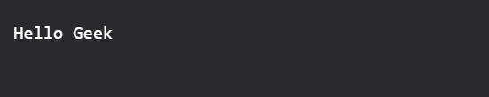
Output:

Slide 18
Play with Python Bool:

Slide 19
Example 1: Integers and Floats as Booleans
Numbers can be used as bool values by using Python’s built-in bool() method. Any integer, floating-point number, or complex number having zero as a value is considered as False, while if they are having value as any positive or negative number then it is considered as True.

Slide 20
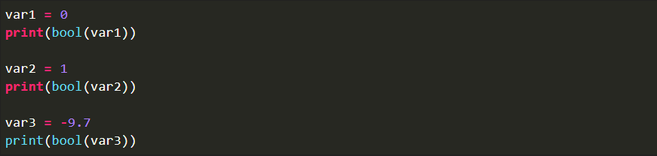
Code:

Slide 21
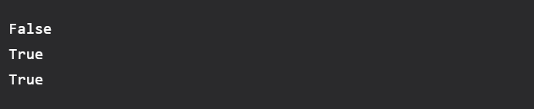
Output:

Slide 22
Play with List in Python:

Slide 23
Example 1: Creating a list in Python
Lists in Python can be created by just placing the sequence inside the square brackets[].

Slide 24
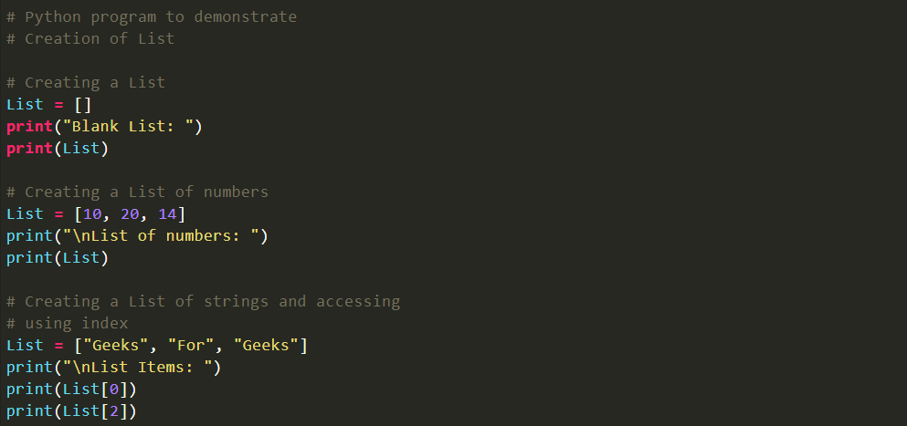
Code:

Slide 25
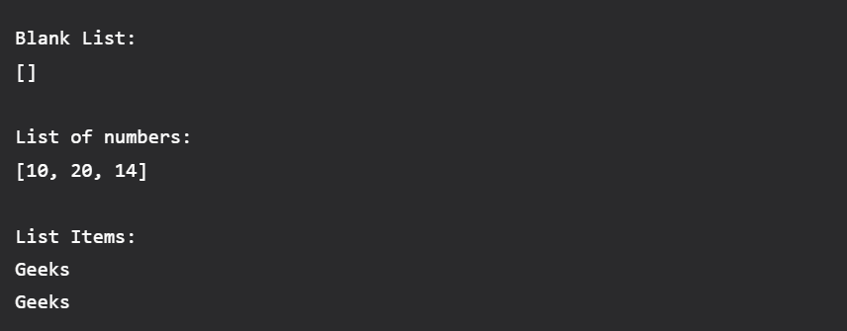
Output:

Slide 26
Example 2: How To Find the Length of a List in Python
Python len() function is an inbuilt function in Python. It can be used to find the length of an object by passing the object within the parentheses of the len function.

Slide 27
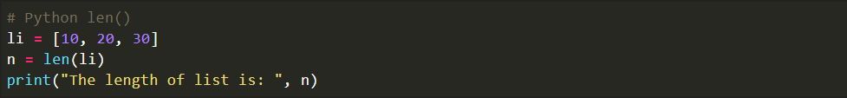
Code:

Slide 28

Output:

Slide 29
Play with Tuple in Python:

Slide 30
Example 1: Find the size of a Tuple in Python
Python len() function is an inbuilt function in Python. It can be used to find the length of an object by passing the object within the parentheses of the len function.

Slide 31
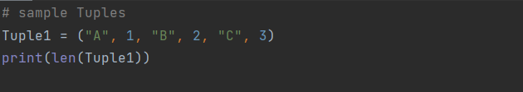
Code:

Slide 32

Output:

